Slide 1
Fragments
Week 8

Slide 2
2.1 Fragments

Slide 3
Contents
What is a Fragment?
Creating a Fragment
Adding a Fragment to an Activity

Slide 4
Fragments
(high-level view)

Slide 5
What is a Fragment?
A Fragment represents a reusable portion of your app's UI.
A fragment defines and manages its own layout, has its own lifecycle, and can handle its own input events.
Fragments can't live on their own.

Slide 6
What is a Fragment?
They must be hosted by an activity or another fragment. The fragment’s view hierarchy becomes part of, or attaches to, the host’s view hierarchy.

Slide 7
Modularity
Fragments introduce modularity and reusability into your activity’s UI by letting you divide the UI into discrete chunks.
Activities are an ideal place to put global elements around your app's user interface, such as a navigation drawer.
Conversely, fragments are better suited to define and manage the UI of a single screen or portion of a screen.

Slide 8
Modularity
In practice, the activity is responsible for displaying the correct navigation UI, while the fragment displays the content with the proper layout.
Dividing your UI into fragments makes it easier to modify your activity's appearance at runtime

Slide 9
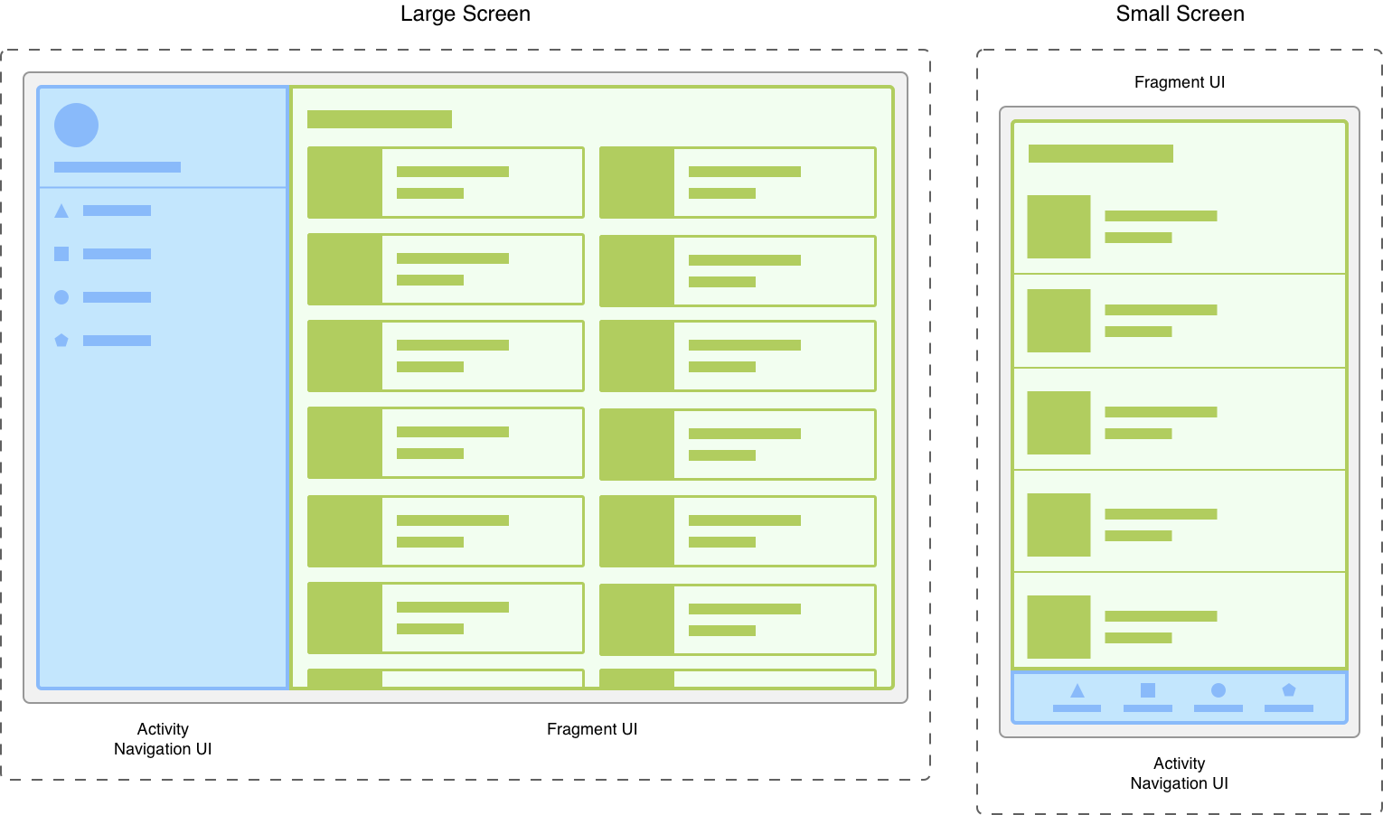
Modularity
Figure 1. Two versions of the same screen on different screen sizes. On the left, a large screen contains a navigation drawer that is controlled by the activity and a grid list that is controlled by the fragment. On the right, a small screen contains a bottom navigation bar that is controlled by the activity and a linear list that is controlled by the fragment.

Slide 10
Creating a Fragment

Slide 11
Creating a Fragment
To create a fragment, extend the Fragment class.
Override its methods to insert your app logic, similar to the way you would create an Activity class.

Slide 12
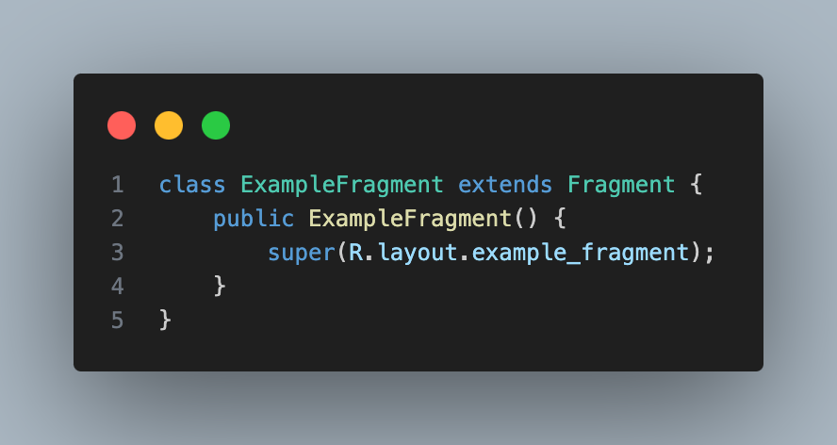
Creating a Fragment
Figure 2. A sample java code to create a minimal fragment that defines its own layout. To achieve this, the fragment's layout resource is provided to the base constructor,

Slide 13
Add a Fragment to an Activity

Slide 14
Add a Fragment to an Activity
You can add your fragment to the activity's view hierarchy either by defining the fragment in your activity's layout file or by defining a fragment container in your activity's layout file and then programmatically adding the fragment from within your activity.

Slide 15
END

